Slide 1
Operating Systems
6. Deadlocks
6-Deadlock
1

Slide 2
Deadlock
A set of blocked processes each waiting for an event that only another process in the set can cause
Example of a possible event
– Resource to become available

Slide 3
Bridge Crossing Example
Traffic only in one direction
Each “half” of the bridge can be viewed as a resource
If a deadlock occurs, it can be resolved if cars back up (preempt resources and rollback)
Several cars may have to be backed up
Starvation is possible

Slide 4


Deadlocks in the Computer World
Word Processor
has exclusive access of
needs
needs
Web browser
has exclusive access of

Slide 5
Deadlocks in Resource Allocation – Examples
Semaphores A and B, initialized to 1 (or: system has 2 tape drives; P0 and P1 each hold one tape drive and each needs another one)
P0 |  | P1
wait | (A); | wait(B);
wait | (B); | wait(A);
150Kbytes memory-space is available
P0 request | (80Kbytes); | P1 request (80Kbytes);
… |  | …
request | (70Kbytes); | request (70Kbytes);
– Deadlock might occur if both processes proceed to the second request

Slide 6
Deadlocks in Resource Allocation – Examples
Message-passing with blocking receive
P0
receive(P1); send(P0, M1);
P1
receive(P0) send(P1 , M0);

Slide 7
Conditions for Deadlock
Four conditions must hold simultaneously for a deadlock to occur [Coffman-et al 1971]
Mutual exclusion: Only one process at a time can use a resource
Hold and wait: A process holding some resource can request additional resources and wait for them if they are held by other processes
No preemption: A resource can only be released voluntarily by the process holding it, after that process has completed its task
Circular wait: There exists a circular chain of 2 or more blocked processes, each waiting for a resource held by the next process in the chain

Slide 8
Resource Allocation & Handling of Deadlocks
Many possible options dealing with deadlocks in an OS!
Deadlock Prevention: Structurally restrict the way in which processes request resources (restriction on Conditions 1-3)
Deadlock Avoidance: Processes are required to specify info in advance about their resource usage
Info: (max) resources required in running state
OS schedules processes in a way that deadlock is avoided
No restrictions on Conditions 1-3 !
Deadlock Detection: Deadlock state allowed followed by recovery
Deadlock Ignorance: Pretend that deadlocks never occur in the system (can be a “solution” sometimes?!…)

Slide 9
Resource Allocation with Deadlock Prevention
Restrain the ways requests can be made
– Attack at least one of the 4 conditions, so that deadlocks are not possible to happen
Mutual Exclusion
Cannot do much here …
Hold and Wait
Must guarantee that when a process requests a resource, it does not hold any other resources
Require process to request and be allocated all its resources at once
Or allow process to request resources only when the process has none
Low resource utilization; starvation possible

Slide 10
Resource Allocation with Deadlock Prevention
No Preemption
If a process holds some resources, requests another resource that cannot be immediately allocated
It release all held resources and request them again
Risk for starvation!
Circular Wait
Impose total ordering of all resource types
Require that each process requests resources in an increasing order of enumeration
For example, e.g., first the tape, then the disk

Slide 11
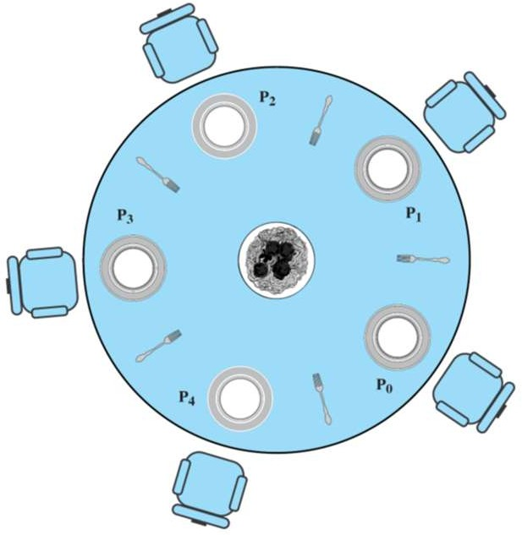
Resource Allocation: System Model
Resource types R₁, R₂, . . ., R_{m}
For example, CPU, memory space, I/O devices, files
Each resource type R_{i} has W_{i} instances
Each process utilizes a resource as follows (as discussed for the dining philosophers):
Request (hungry)
Use (eat)
Release

Slide 12
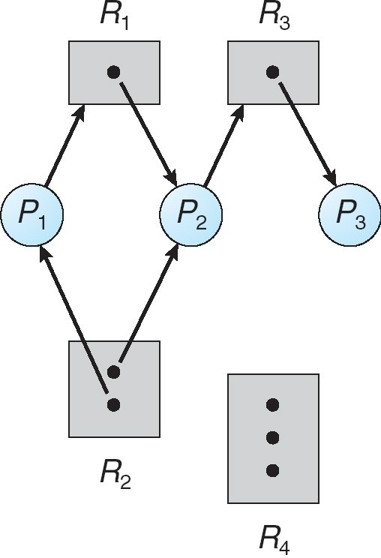
Resource Allocation Graph
A set of vertices V and a set of edges E
V is partitioned into two sets
P = {P₁, P₂, …, P_{n}} the set of processes
R = {R₁, R₂, …, R_{m}} the set of resource types
Request edge: P_{i} → R_{j}
Assignment edge: R_{j} → P_{i}

Slide 13
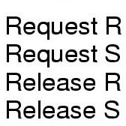
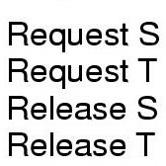
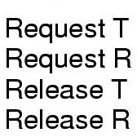

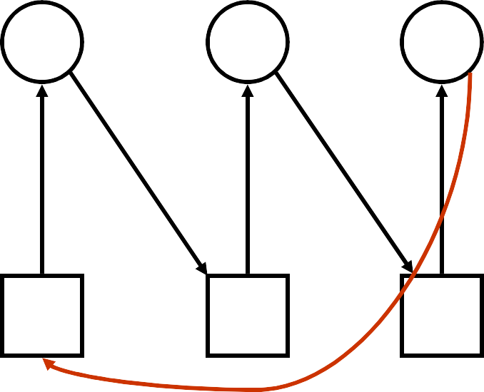





Resource Allocation Graph – Example
A
B
C
A
B
C
 | R | S | T
6-Deadlock |  | DEADLOCK 13
Notes:
ssigne d

Slide 14

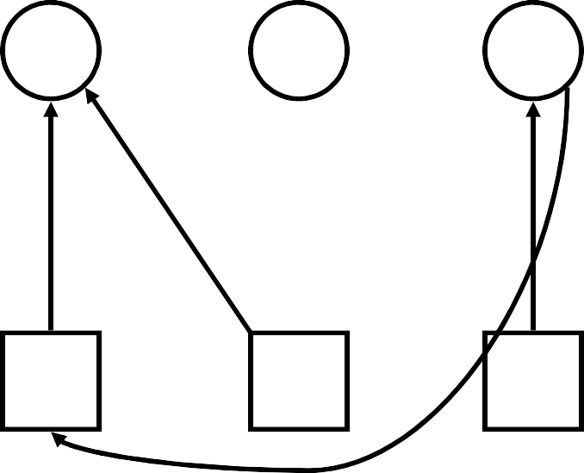





Resource Allocation Graph – Example
A
B
C
A
B
C
R S T
NO DEADLOCK
6-Deadlock
14

Slide 15
Basic Facts
Graph contains no cycles ⇒ no deadlock
(i.e., cycle is always a necessary condition for deadlock)
If graph contains a cycle ⇒
if one instance per resource type, then deadlock
if several instances per resource type, then possibility of deadlock
Theorem:
Assume we apply the immediate-allocation-method
If the corresponding graph contains a knot, i.e. a strongly connected component and no outgoing edges (sinks), we encounter a deadlock
15

Slide 16
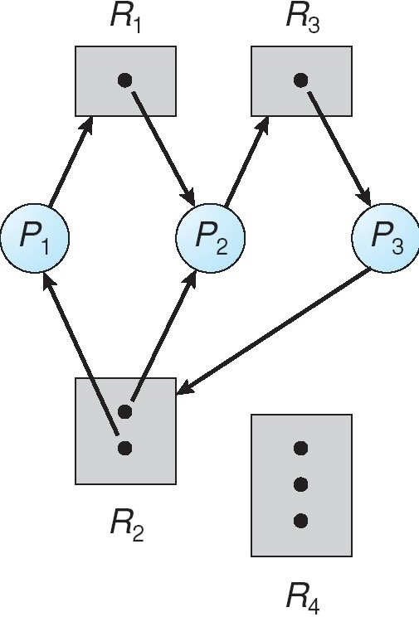
Resource Allocation Graph: Deadlock
Strongly connected component and no outgoing edge
16

Slide 17
Resource Allocation Graph: Cycle But No Deadlock
Strongly connected component with an outgoing edge
17

Slide 18
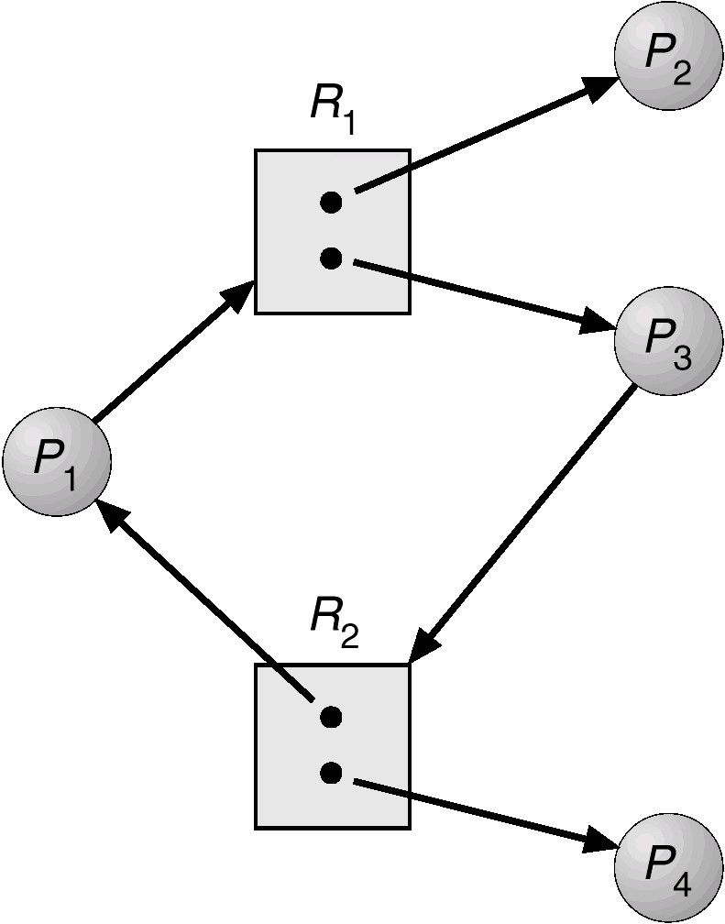
Resource Allocation Graph: Cycle But No Deadlock
18

Slide 19
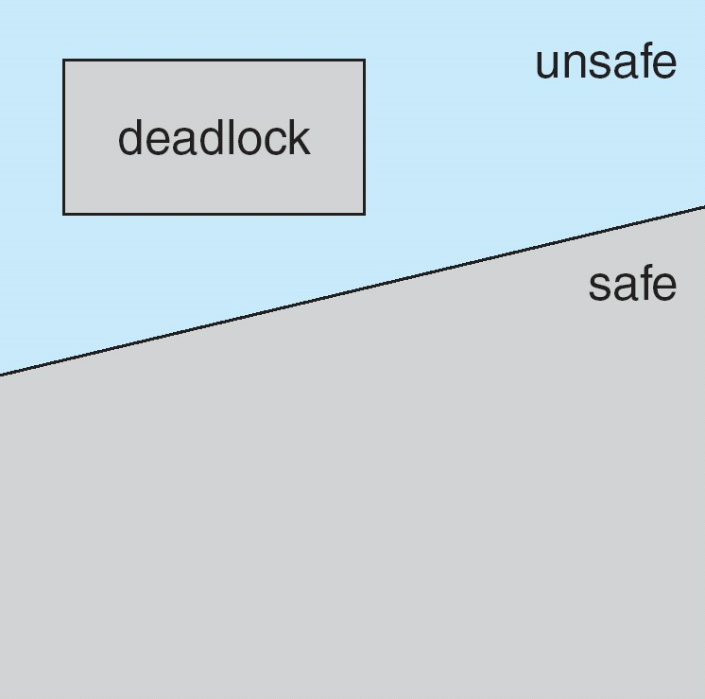
Save, Unsafe, and Deadlock States
Possible global OS states depending on the current resource allocation of processes
Safe state
No deadlocks in the horizon
OS can find a schedule which avoids a deadlock
Unsafe state
Deadlock might occur (later…)
For example, future resource requests
Note: Safe states require information on future behavior of processes!
19

Slide 20
Resource Allocation with Deadlock Avoidance
Requires a priori information available
For instance, each process declares maximum number of resources of each type that it may need (e.g., memory/disk pages)
Deadlock-avoidance Algorithm
Examines the resource-allocation state…
Available and allocated resources
Maximum possible demands of the processes
Avoidance = Ensure that system will not enter an unsafe state
Idea: If satisfying a request will result in an unsafe state, requesting process is suspended until enough resources are freed by processes that will terminate in the meanwhile
20

Slide 21
Safety Checking: Determining a Safe State
Safe state = a safe sequence <P₁, P₂, …, P_{n}> of terminating all processes
For each P_{i}, the requests can still be granted by
Currently available resources
Resources held by P₁, P₂, …, P_{i-1}
The system can schedule the processes as follows
If P_{i} ’s need for resources cannot be satisfied immediately, then it can
Wait until all P₁, P₂, …, P_{i-1} have finished
Obtain needed resources, execute, release resources, terminate
Then the next process can obtain its needed resources, and so on
21

Slide 22
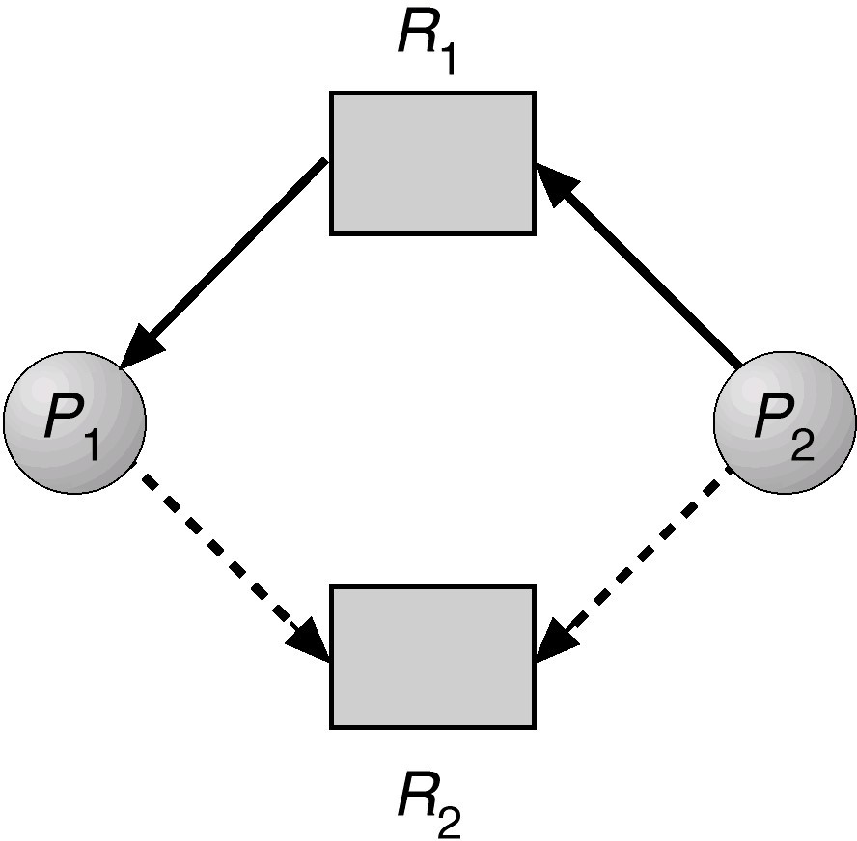
Simple Example (Snapshot 1)
 | Allocation | Max | Need | Available
 | A B | A B | A B | A B
P1 | 1 0 | 1 1 | 0 1 | 0 1
P2 | 0 0 | 1 1 | 1 1
P2 currently requests resource A (hold by P1)
– The system is in a safe state since the sequence < P1, P2> satisfies
safety criteria
A
Claim edge: May request resource at some time in future
B
22
Notes:
Allocation
Max
Need
Available
A B
A B
A B
A B
P1
1 0
1 1
0 1
0 1
P2
0 0
1 1
1 1

Slide 23
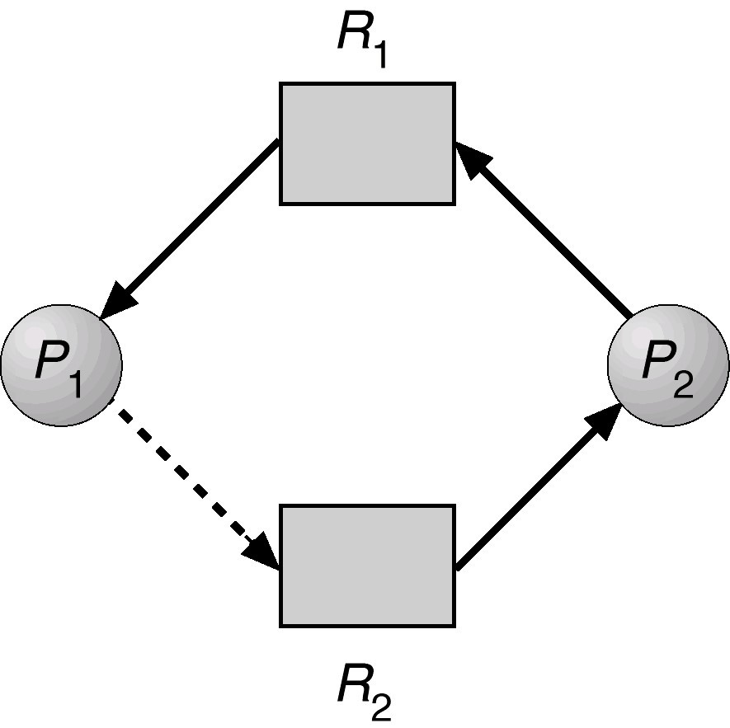
Simple Example (Snapshot 2)
Consider P₂ also requests B Allocation | Max | Need | Available
A B | A B | A B | A B
P1 1 0 | 1 1 | 0 1 | 0 0
P2 0 1 | 1 1 | 1 0
Allocating B to P2 leaves the system in an unsafe state since there is no sequence that satisfies safety criteria (Available vector is 0 !)
A
6-Deadlock
B
2
3

Slide 24
Banker’s Algorithm for Deadlock Avoidance
Data Structures
Max: n x m matrix (n =no. of processes, m= no. of resource types)
Max [i,j] = k : P_{i} may request max k instances of resource type R_{j}
Allocation: n x m matrix
Allocation[i,j] = k : P_{i} is currently allocated k instances of R_{j}
Available: length m vector
Available [j] = k : k instances of resource type R_{j} available
Need: n x m matrix
Need [i,j] = Max[i,j] – Allocation[i,j]: potential max request by P_{i} for resource type R_{j}
RECALL: Avoidance = Ensure that system will not enter unsafe state

Slide 25
Banker’s Algorithm: Safety Check
Work and Finish: Auxiliary vectors of length m and n, respectively
init:
Work := Available
Finish[i] = false for i = 1,2, …, n.
while ( i s.t. (Finish [i] = false) && (Need_{i} <= Work )) do
Work := Work + Allocation_{i} Finish[i] := true
if (∀i Finish[i] = true) then
system is in a safe state
else
state is unsafe
Notes:
∀� �(�)∀ for every

Slide 26
Example System
Five processes: P₀ … P₄
Three resource types:
A (10 instances)
B (5 instances)
C (7 instances)

Slide 27
Example System
System state: Is it safe?
Process
P₀
P₁
P₂
P₃
P₄
Max
A B C
7 5 3
3 2 2
9 0 2
2 2 2
4 3 3
Allocation
A B C
0 1 0
2 0 0
3 0 2
2 1 1
0 0 2
Available
A | B | C
3 | 3 | 2

Slide 28
Example System
Need_{i} = Max_{i} – Allocation_{i}
Need matrix
Process | A | B | C
P₀ | 7 | 4 | 3
P₁ | 1 | 2 | 2
P₂ | 6 | 0 | 0
P₃ | 0 | 1 | 1
P₄ | 4 | 3 | 1

Slide 29
Example System
Process
P₀
P₁
P₂
P₃
P₄
Need
A B C
7 4 3
1 2 2
6 0 0
0 1 1
4 3 1
Allocation
A B C
0 1 0
2 0 0
3 0 2
2 1 1
0 0 2
Work
A | B | C
3 | 3 | 2
Safe Sequence: <>

Slide 30
Example System
Process
P₀
P₁
P₂
P₃
P₄
Need
A B C
7 4 3
1 2 2
6 0 0
0 1 1
4 3 1
Allocation
A B C
0 1 0
2 0 0
3 0 2
2 1 1
0 0 2
Work
A | B | C
3 | 3 | 2
5 | 3 | 2
Safe Sequence: < P1>

Slide 31
Example System
Process
P₀
P₁
P₂
P₃
P₄
Need
A B C
7 4 3
1 2 2
6 0 0
0 1 1
4 3 1
Allocation
A B C
0 1 0
2 0 0
3 0 2
2 1 1
0 0 2
Work
A | B | C
3 | 3 | 2
5 | 3 | 2
7 | 4 | 3
Safe Sequence: < P1, P3>

Slide 32
Example System
Process
P₀
P₁
P₂
P₃
P₄
Need
A B C
7 4 3
1 2 2
6 0 0
0 1 1
4 3 1
Allocation
A B C
0 1 0
2 0 0
3 0 2
2 1 1
0 0 2
Work
A | B | C
3 | 3 | 2
5 | 3 | 2
7 | 4 | 3
7 | 4 | 5
Safe Sequence: < P1, P3, P4 >

Slide 33
Example System
Process
P₀
P₁
P₂
P₃
P₄
Need
A B C
7 4 3
1 2 2
6 0 0
0 1 1
4 3 1
Allocation
A B C
0 1 0
2 0 0
3 0 2
2 1 1
0 0 2
Work
A | B | C
3 | 3 | 2
5 | 3 | 2
7 | 4 | 3
7 | 4 | 5
7 | 5 | 5
Safe Sequence: <P1, P3, P4, P0,P2>

Slide 34
Banker’s Algorithm: Resource Allocation
For each new Request_{i} do
Assert Request_{i} ≤ Need_{i}
if Request_{i} > Available ⇒ P_{i} must wait
else
remember the current resource-allocation state S; Available := Available - Request_{i};
Allocation_{i} := Allocation_{i} + Request_{i}; Need_{i} := Need_{i} – Request_{i};
if (safety-check is OK) ⇒
commit allocation of resources to P_{i}
else ( unsafe ) ⇒
P_{i} must wait
restore resource-allocation state S;

Slide 35
Banker’s Algorithm – Example
Processes P1 request (1,0,2)
 | Allocation | Max | Need | Available
 | A B C | A B C | A B C | A B C
P0 | 0 1 0 | 7 5 3 | 7 4 3 | 3 3 2
P1 | 2 0 0 | 3 2 2 | 1 2 2
P2 | 3 0 2 | 9 0 2 | 6 0 0
P3 | 2 1 1 | 2 2 2 | 0 1 1
P4 | 0 0 2 | 4 3 3 | 4 3 1
Check REQUEST₁ ≤ Need₁ (that is (1,0,2) ≤ (1,2,2))
Check that Request₁ ≤ Available (that is, (1,0,2) ≤ (3,3,2)) ⇒ true

Slide 36
Banker’s Algorithm – Example
Processes P1 request (1,0,2)
 | Allocation | Max | Need | Available
 | A B C | A B C | A B C | A B C
P0 | 0 1 0 | 7 5 3 | 7 4 3 | 2 3 0
P1 | 3 0 2 | 3 2 2 | 0 2 0
P2 | 3 0 2 | 9 0 2 | 6 0 0
P3 | 2 1 1 | 2 2 2 | 0 1 1
P4 | 0 0 2 | 4 3 3 | 4 3 1
Executing safety algorithm shows that sequence <P1, P3, P4, P0, P2> satisfies safety requirement

Slide 37
Banker’s Algorithm – Example
 | Allocation | Max | Need | Available
 | A B C | A B C | A B C | A B C
P0 | 0 1 0 | 7 5 3 | 7 4 3 | 2 3 0
P1 | 3 0 2 | 3 2 2 | 0 2 0
P2 | 3 0 2 | 9 0 2 | 6 0 0
P3 | 2 1 1 | 2 2 2 | 0 1 1
P4 | 0 0 2 | 4 3 3 | 4 3 1
Can request for (3,3,0) by P4 be granted?
Can request for (0,2,0) by P0 be granted?

Slide 38
Deadlock Detection & Recovery
Allow system to enter a deadlock state
Detection algorithm
Using Banker’s algorithm idea
Resources can have multiple instances
Using resource allocation graph
Resources have single instance
Recovery scheme

Slide 39
Deadlock Detection Using Banker’s Algorithm
Similar as detecting unsafe states using Banker’s algorithm
How is similarity explained?
If they cost the same why not use avoidance instead of detection & recovery?
Data structures
Available: Vector of length m: number of available resources of each type
Allocation: n x m matrix: number of resources of each type currently allocated to each process
Request: n x m matrix: current request of each process
Request [i j] = k: P_{i} is requesting k more instances of resource type R_{j}

Slide 40
Deadlock Detection Using Banker’s Algorithm
Work and Finish: Auxiliary vectors of length m and n, respectively
init:
Work := Available
Finish[i] = false for i = 1,2, …, n.
while ( i s.t. (Finish [i] = false) && (Request_{i} <= Work )) do
Work := Work + Allocation_{i} Finish[i] := true
if ( i Finish[i] = false) then
system is in a deadlock state

Slide 41
Example of Detection Algorithm
Five processes P₀ through P₄
Three resource types
– A (7 instances), B (2 instances), and C (6 instances)
Snapshot at time T₀
 | Allocation | Request | Available
 | A B C | A B C | A B C
P₀ | 0 1 0 | 0 0 0 | 0 0 0
P₁ | 2 0 0 | 2 0 2
P₂ | 3 0 3 | 0 0 0
P₃ | 2 1 1 | 1 0 0
P₄ | 0 0 2 | 0 0 2
Sequence <P₀, P₂, P₃, P₁, P₄> will result in Finish[i] = true for all i

Slide 42
Example of Detection Algorithm
P₂ requests an additional instance of type C
Snapshot at time T₀
 | Allocation | Request | Available
 | A B C | A B C | A B C
P₀ | 0 1 0 | 0 0 0 | 0 0 0
P₁ | 2 0 0 | 2 0 2
P₂ | 3 0 3 | 0 0 1
P₃ | 2 1 1 | 1 0 0
P₄ | 0 0 2 | 0 0 2
State of system?
Can reclaim resources held by process P₀, but insufficient resources to fulfill other processes’ requests
Deadlock exists, consisting of processes P₁, P₂, P₃, and P₄

Slide 43
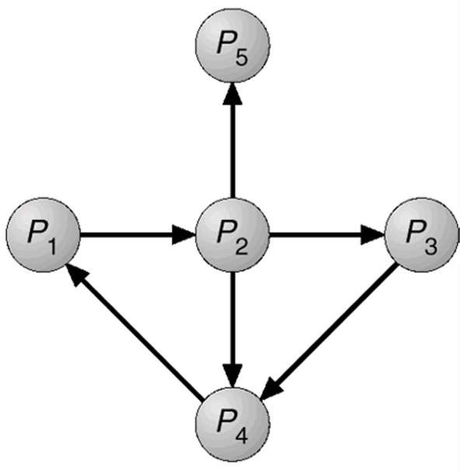
Deadlock Detection Using Graphs
Deadlock detection using wait-for graph
Variant of resource allocation graph
Wait-for graph only contains edges between processes
Edge P_{i} → P_{j} in wait-for graph implies
Process P_{i} is waiting for P_{j} to release a resource that P_{i} needs
Wait-for graph is obtained from resource allocation graph
Removing the resource nodes
Collapsing the appropriate edges
Edge P_{i} → P_{j} exists in wait-for graph if and only if
Resource allocation graph contains two edges
P_{i} → R_{q} and R_{q} → P_{j} for some resource R_{q}

Slide 44
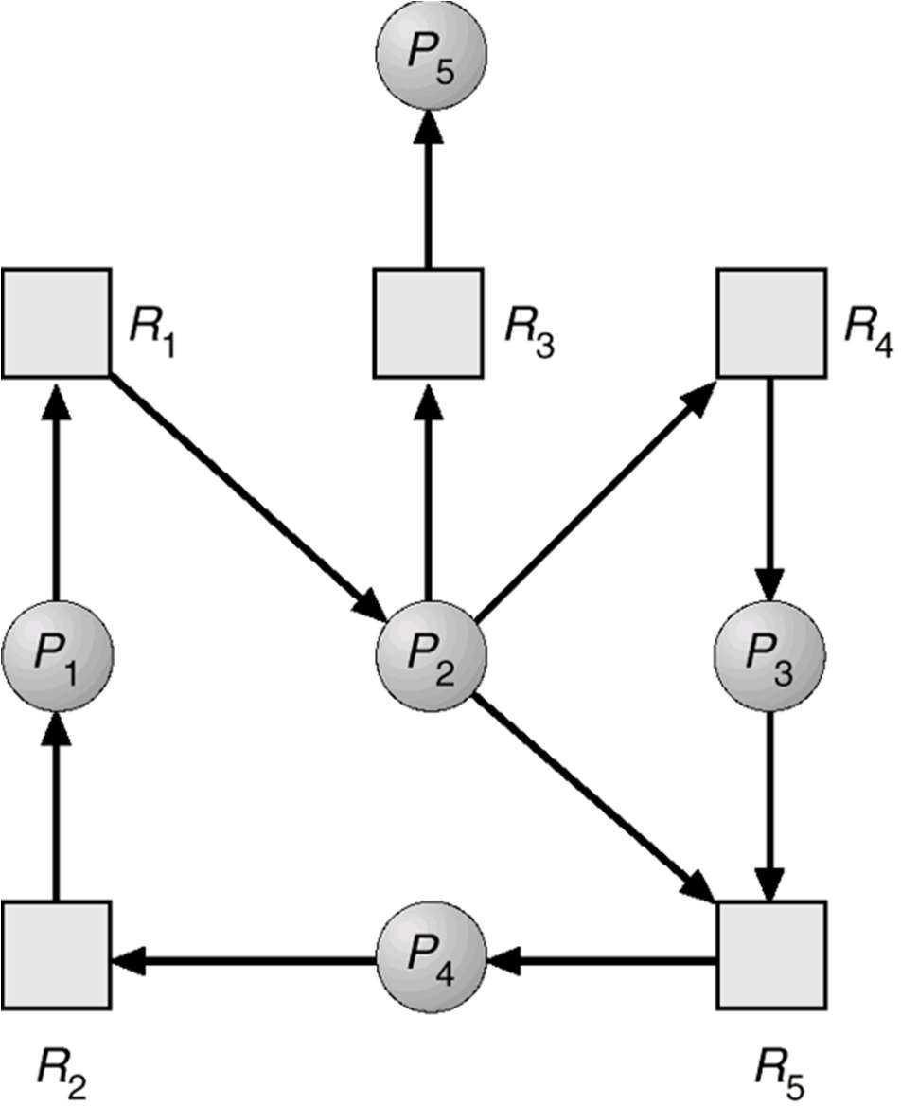
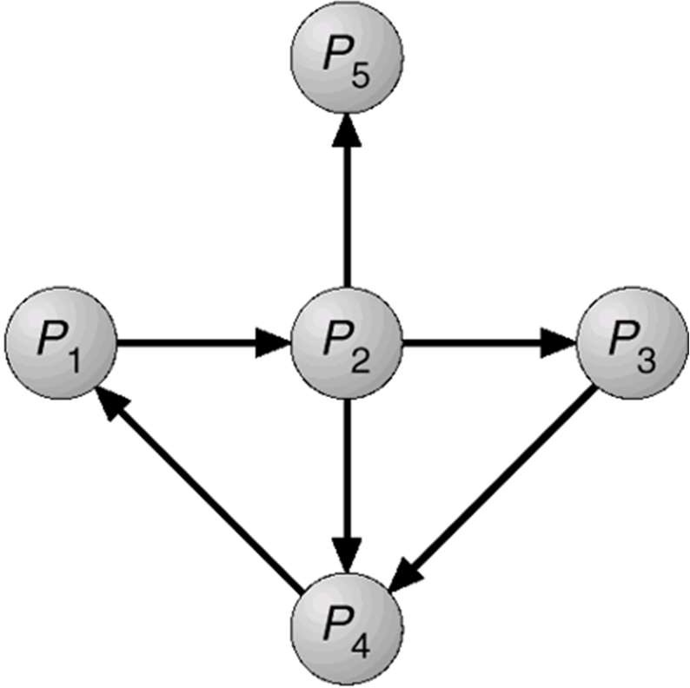
Deadlock Detection Using Graphs
Resource-Allocation Graph
Wait-for graph

Slide 45
Deadlock Detection Using Graphs
Deadlock exists if and only if wait-for graph contains cycle
Periodically invoke an algorithm that searches for a cycle in graph
Which algorithm can be used for deadlock detection?
An algorithm to detect a cycle in a graph requires an order of n² operations
Where n is the number of vertices in the graph

Slide 46
Detection Algorithm Usage
Note: cost for detection algorithm is the same as that for the Bankers algorithm!
When, and how often, to invoke depends on
How often a deadlock is likely to occur?
How many processes will need to be rolled back?
If algorithm is invoked arbitrarily, there may be many cycles in the resource graph
We would not be able to tell which of the many deadlocked processes “caused” the deadlock

Slide 47
How to Recover From Deadlocks
Once there is a deadlock situation
No way that all processes can proceed with the current allocation state
Two main techniques to recover
Process Termination
Resource Preemption

Slide 48
Recovery From Deadlock: Process Termination
Abort all deadlocked processes
Most common
Long computations may be lost
Abort one process at a time until deadlock is eliminated
Need to run after every abort another instance of the deadlock detection algorithm
In which order should we choose to abort? Criteria?
Least amount of processor time consumed so far
Least amount of output produced so far
Most estimated time remaining
Least total resources allocated so far
Lowest priority

Slide 49
Recovery From Deadlock: Resource Preemption
Select a victim
Which resources to preempt from which processes
As in process termination, determine order of preemption to minimize cost
Rollback
Return to some safe state, restart process from that state
Checkpointing necessary
Watch for starvation
Resources may always be preempted from same process
A process must only be picked as victim only a (small) finite no. of times
Number of rollbacks are a cost factor

Slide 50
Combined Approach to Deadlock Handling
Combine the three basic approaches
Prevention, avoidance, detection
Can use the optimal approach for each type of resources in the system
Approach
Group resources into number of different resource classes
Use linear ordering to prevent deadlocks between resource classes (i.e., prevent circular wait)
Use most appropriate technique for handling deadlocks within each class, e.g.,
Swap space (e.g., blocks in disk): Prevention by preallocation
Process resources (e.g., files): Avoidance by knowing max needs
Main memory: Prevention by preemption
Internal (e.g., I/O channels): Prevention by ordering

Slide 51
Summary
Studied conditions when deadlocks occur
Discussed options to deal with deadlocks
Most operating systems completely ignore the problem
Unix, Windows, …
None of the approaches suitable for all resources
Possibly need to select optimal approach for each class of resource

Slide 52

Any Question So Far?

